Slide 1


Data Visualization and Crowd Analysis using ML Techniques
Ensuring social distance in crowded places by using AI in CCTV footages

Slide 2

PROBLEM STATEMENT:
Corona virus and Overcrowding:
The rapid spread of the virus that causes COVID-19 has sparked alarm worldwide.
The World Health Organization(WHO) has declared this rapidly spreading coronavirus outbreak a pandemic.
The virus can spread from person to person so crowding is an important factor which has a strong correlation with the disease incidence and severity.
Why do we need crowd analysis?
The larger the crowd the greater the chance that someone in it will have the virus.
So to stop the spread of virus we need to control the crowd. Our project alerts the authorities when there is a crowd in a specific area.
This is done by fetching the data from the CCTV camera and an algorithm is used to calculate the number of people, which helps the authorities to taken action accordingly.

Slide 3
SOLUTION
As the COVID-19 outbreak ramped up, the first and foremost aim of our project is to flatten the curve of the virus outbreak by controlling the crowd.
It is an application which tracks the crowd in a specific area by fetching the data from the CCTV camera in public places.
The fetched data is processed through an algorithm to identify the number of people. When the group exceeds the safe limit, it alerts the authorities who are in and around the area.
Tools used : Android studio, Github, Slack, Webstorm, Firebase Hosting, Firebase Database.
Uses of the Tools: Slack for workplace communication, Firebase hosting for hosting our website and firebase provides high scalability , Webstorm for web application development, GitHub for version control, Androdi studio for developing android apps.
By linking the IP address of the CCTV in the website the connection of a new CCTV is made easily.
The Scalability of the web application is updatable, and also not skilled person is required use the website, thus the Usability is also easy.

Slide 4
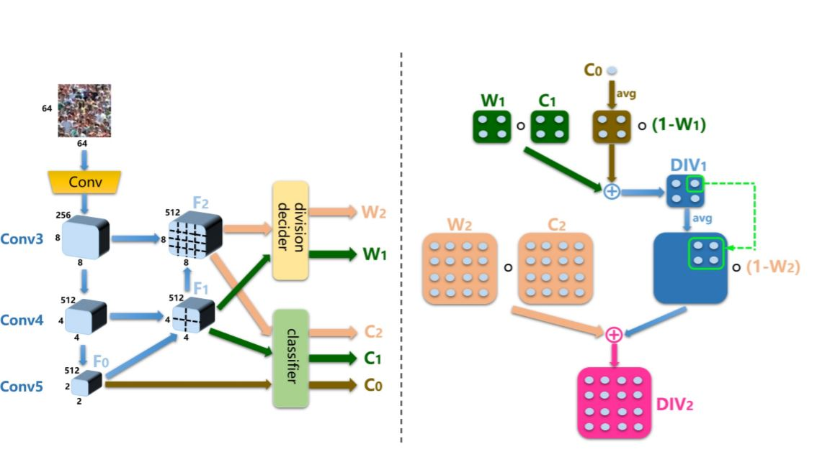
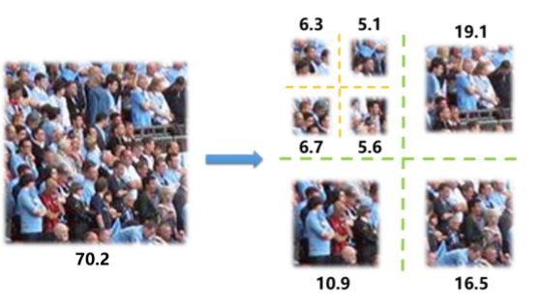
METHODOLOGY - Spatial Divide and Conquer Algorithm

Slide 5
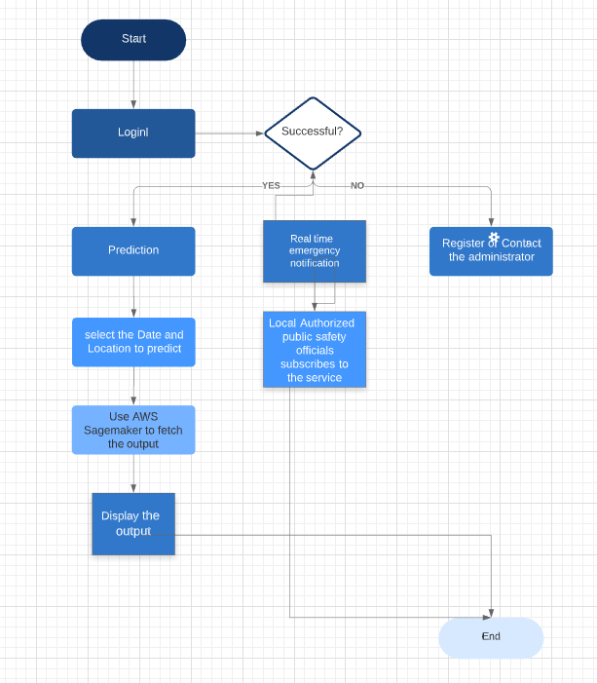
Concept of GOD’S EYE: https://www.youtube.com/watch?v=XheRfFbHLRU&feature=youtu.be
Flow diagram

Slide 6

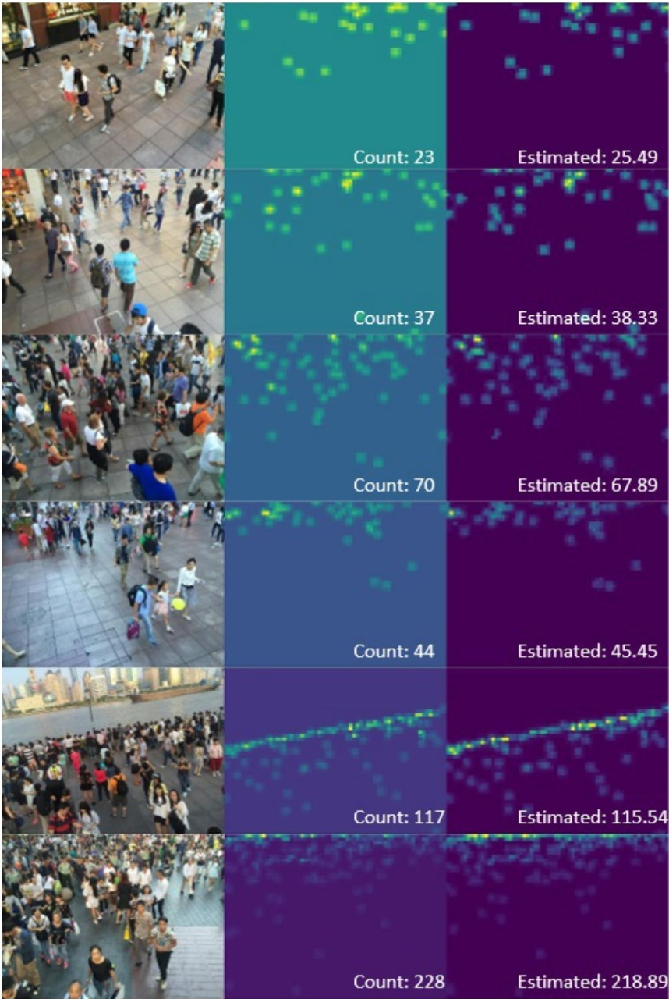
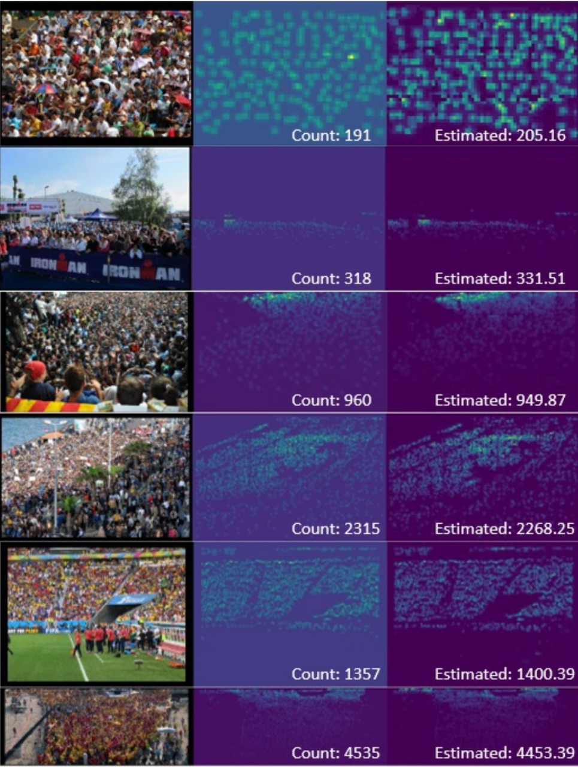
DATASETS
SHANGAI DATA SET UCF_QNRF DATA SET

Slide 7
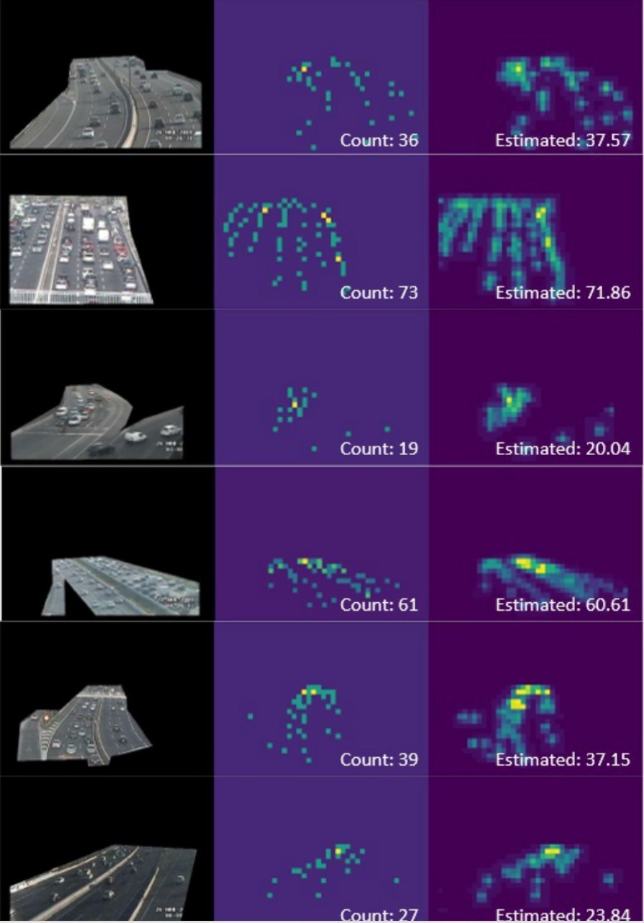
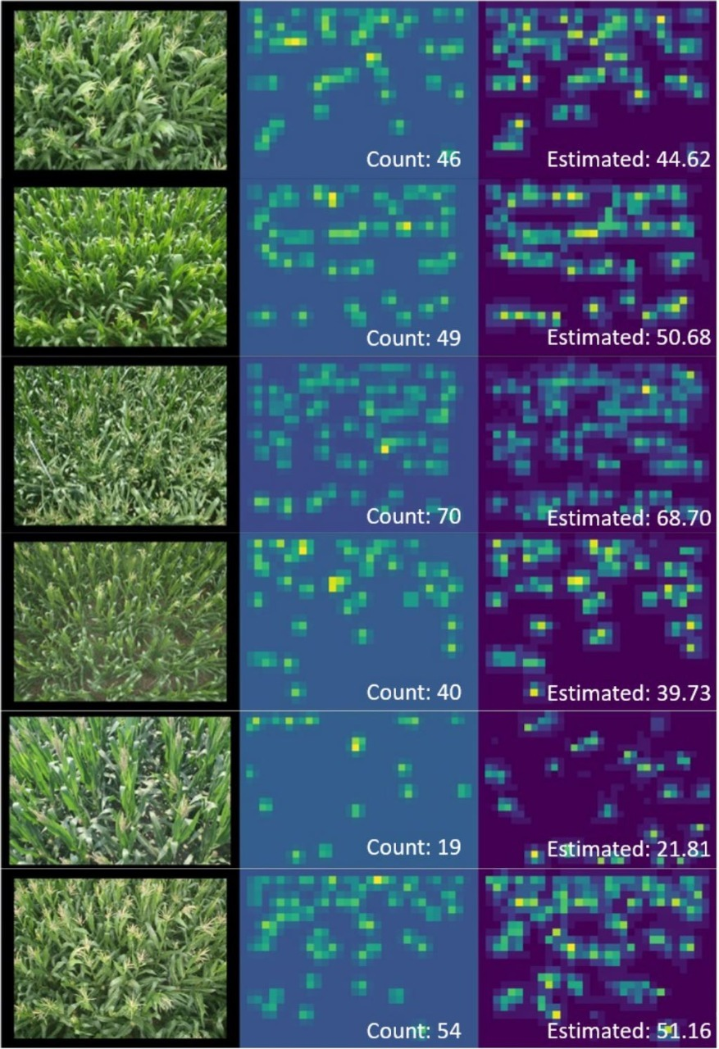
TRANCOS DATA SET MTC DATA SET

Slide 8
WORKING PROTOTYPE
Idea Video - Click here for Idea video
Demo Video - Click here for Demo link

Slide 9
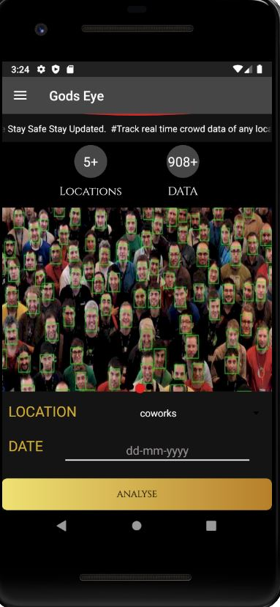

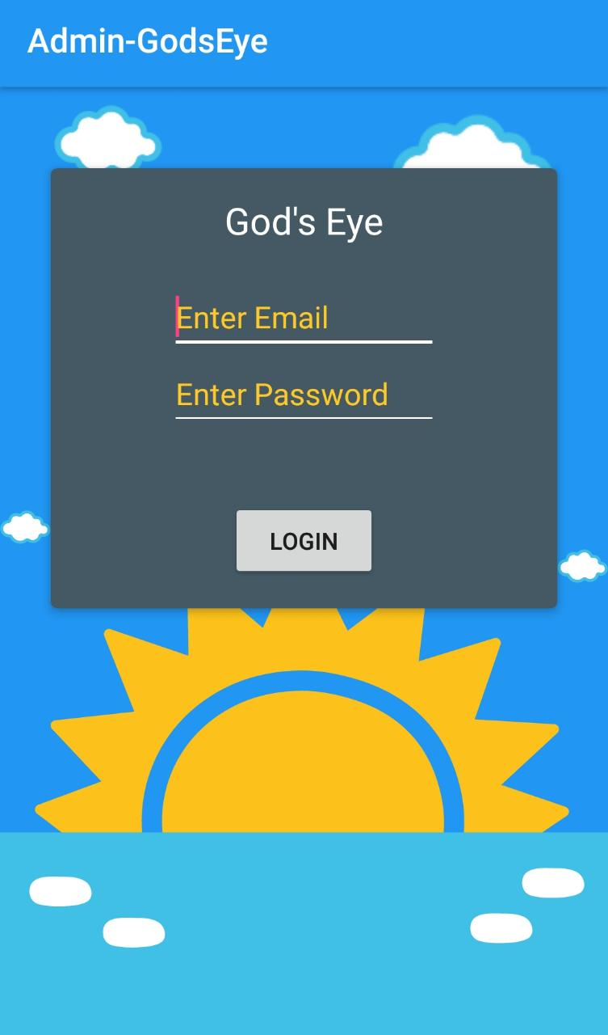
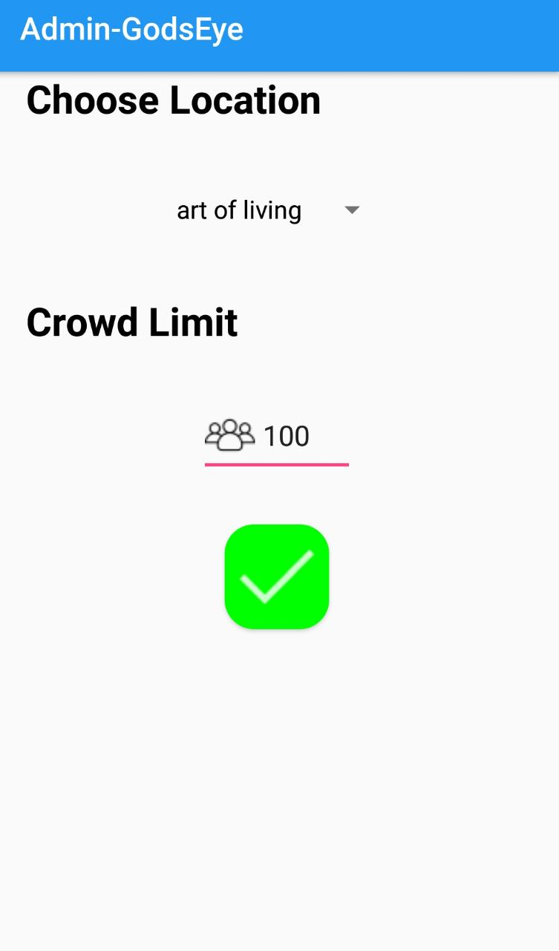
ATTACHMENTS
Github Repo : Click here

Slide 10
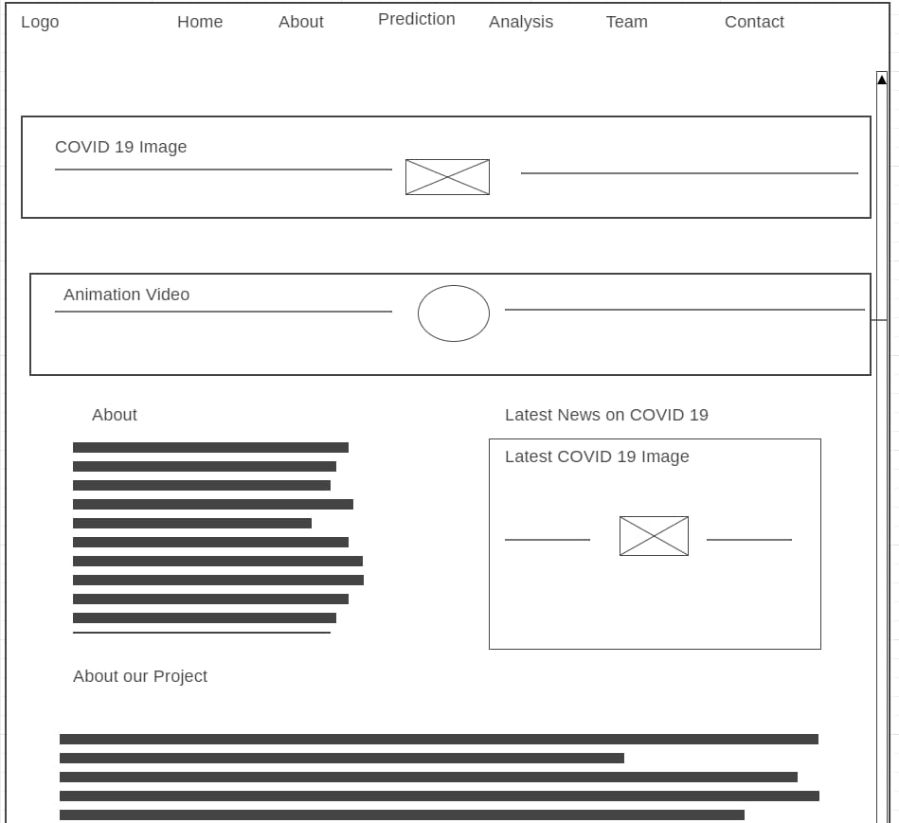
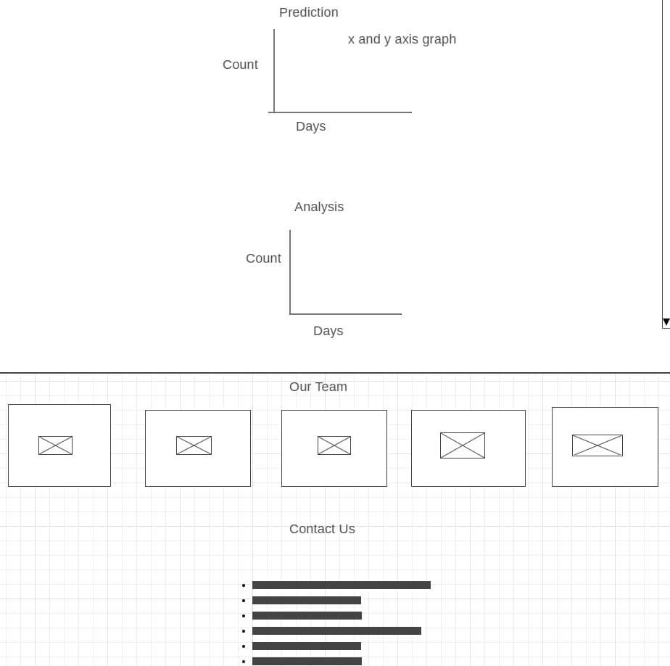
Wireframe for web

Slide 11
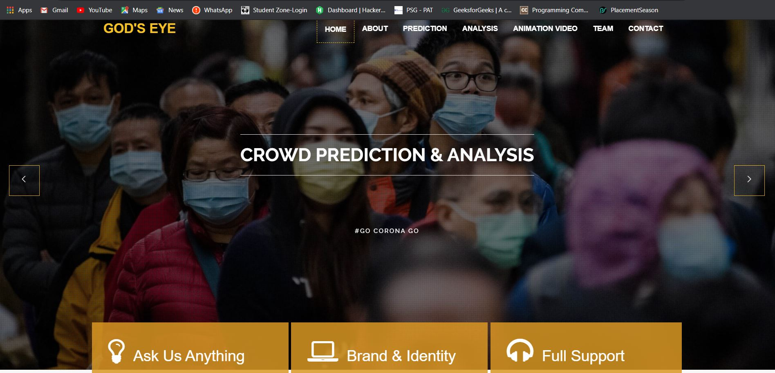

Slide 12
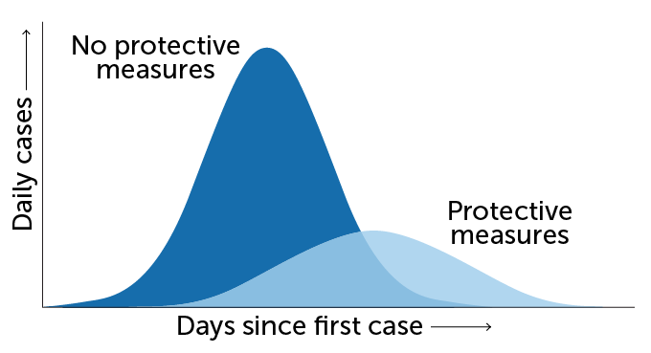
SOCIETAL IMPACT/ NOVELTY
As discussed earlier our project aims in flattening the curve of the virus outbreak.
Even without total isolation, studies of disease dynamics suggest that shrinking social circles can make a huge difference.
It helps the police officers to identify the crowed place and they can avoid the crowd and prevent the virus from spreading.
So this project would definitely contribute to the control if this global pandemic.

Slide 13
FUTURE SCOPE
This application on slight modification can be used as adaptive traffic signal control system. By analysing the traffic in the roads the time duration of the signals and be modified respective to the traffic.
The application can also be modified to help the farmers in harvesting. Farmers can predict the harvest season based on previous year data which will help them to harvest properly.
Example, the increase in the price of the onions last year because it was harvested in wrong time of the season.

Slide 14
THANK YOU

